Slide 1
2020 Preliminary Budget and Tax Levy

Slide 2
The budget is the single most important policy document a local government adopts

Slide 3
2020 Budget: What is it?
Statement of Priorities
Control, Management,
and Planning Tool
Our WHY:
To Make Alexandria
the Place You Choose

Slide 4
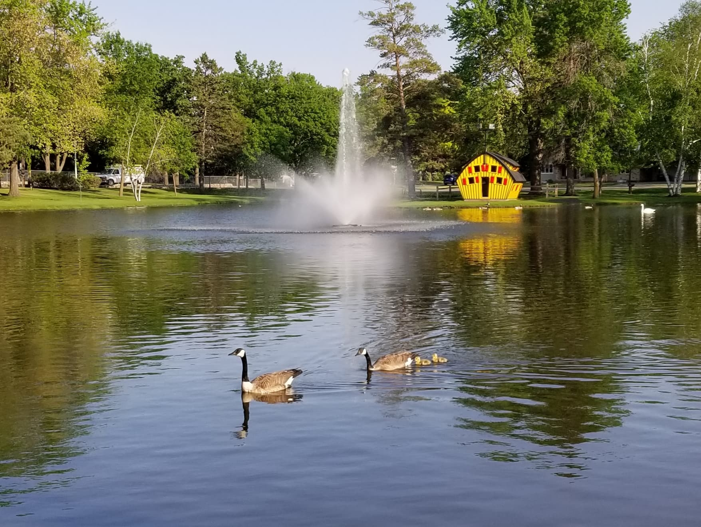
Strategic Alignment
Notes:
Photo by Tamarcus Brown on Unsplash

Slide 5
Operational Excellence
1
Completion of Program Inventory
Maintained Required Fund Balance in the General Fund
Implementation of position budgeting for 2020 budget
Introduction of online job application system
Launch of online building inspections
What’s this section about?
Elections Team

Slide 6
Long Term Planning
2
Adoption of Comprehensive Plan in near future
Fairgrounds Task Force/Fairgrounds Master Plan
City Hall Needs Assessment
What’s this section about?
Runestone Community Center

Slide 7
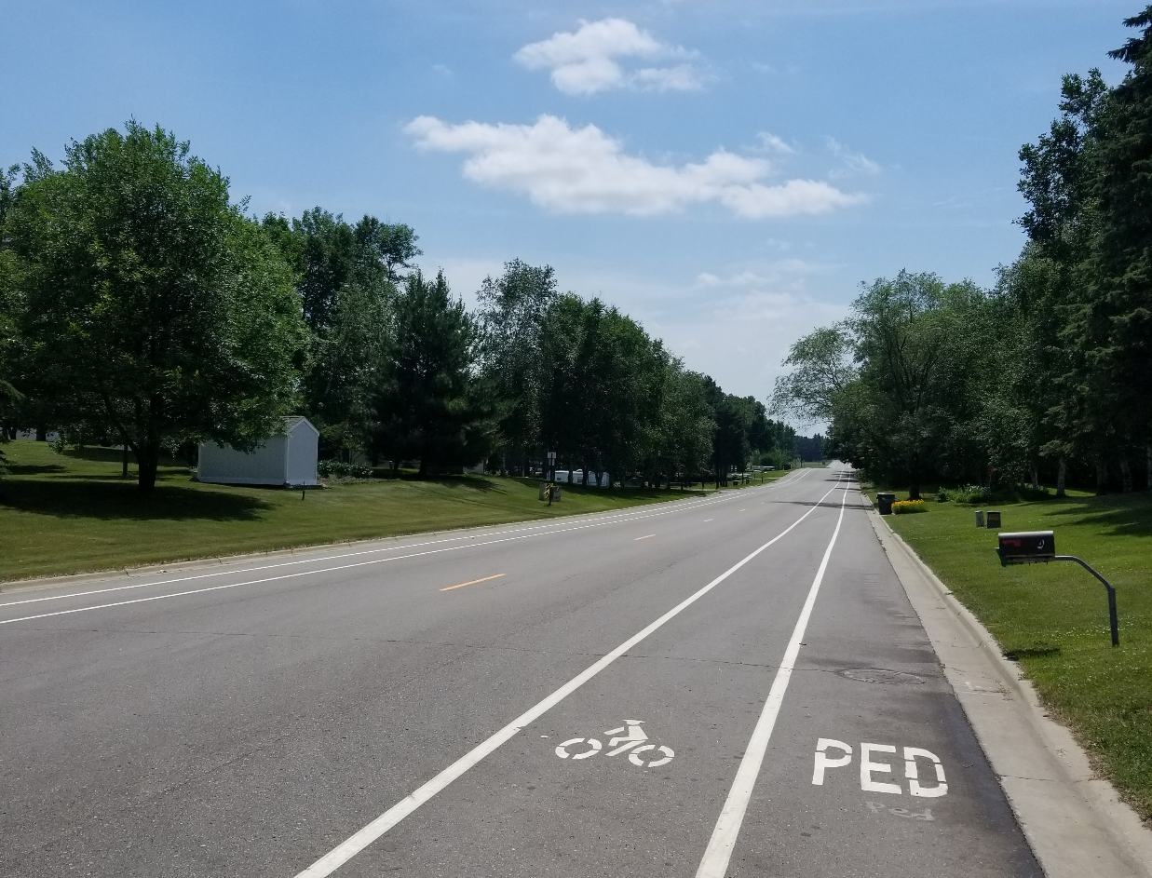
Sustainable Infrastructure
3
Enhanced coordination among utility providers (City, ALASD, ALP)
Street Improvement Plan and Street Reconstruction Bond

Slide 8
Safe Communities
4
Body Camera implementation
Recruitment of two experienced patrol officers and new firefighters
172 nuisances brought into compliance
Emergency Management cooperation with Douglas County
What’s this section about?

Slide 9
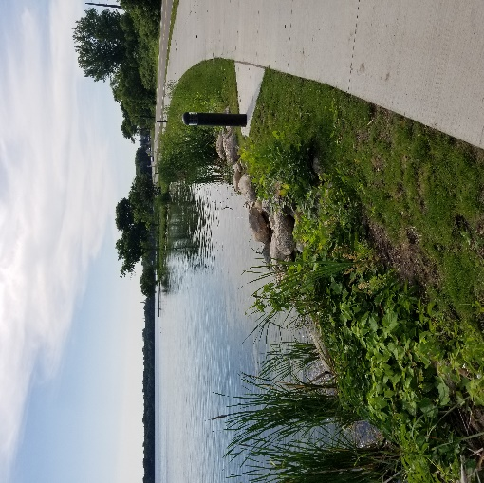
Economic Vitality
5
Completion of Housing Study
Construction of over 200 new apartment units
Housing Trust Fund
Workforce Development Housing Grant
Revolving Loan Fund assisted four projects with $618,500 in loans
Agnes Blvd

Slide 10
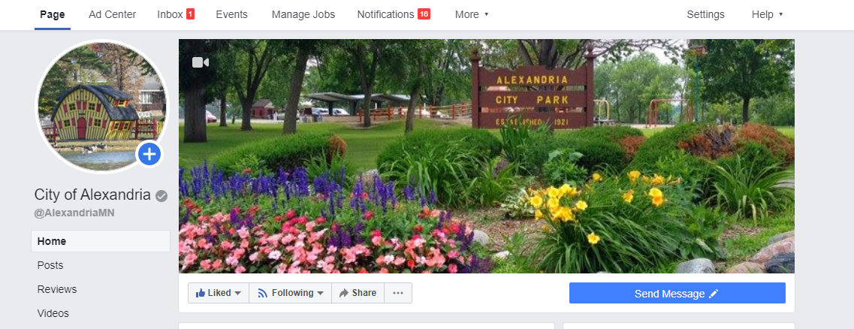
Communications
6
Coffee with the Council
Pride of the Lakes collaboration
Social Media
Q12 Engagement Survey
Strengths Training
City’s Facebook page

Slide 11
$0.24
Of each taxpayer dollar supports public safety through the Police and Fire Departments

Slide 12
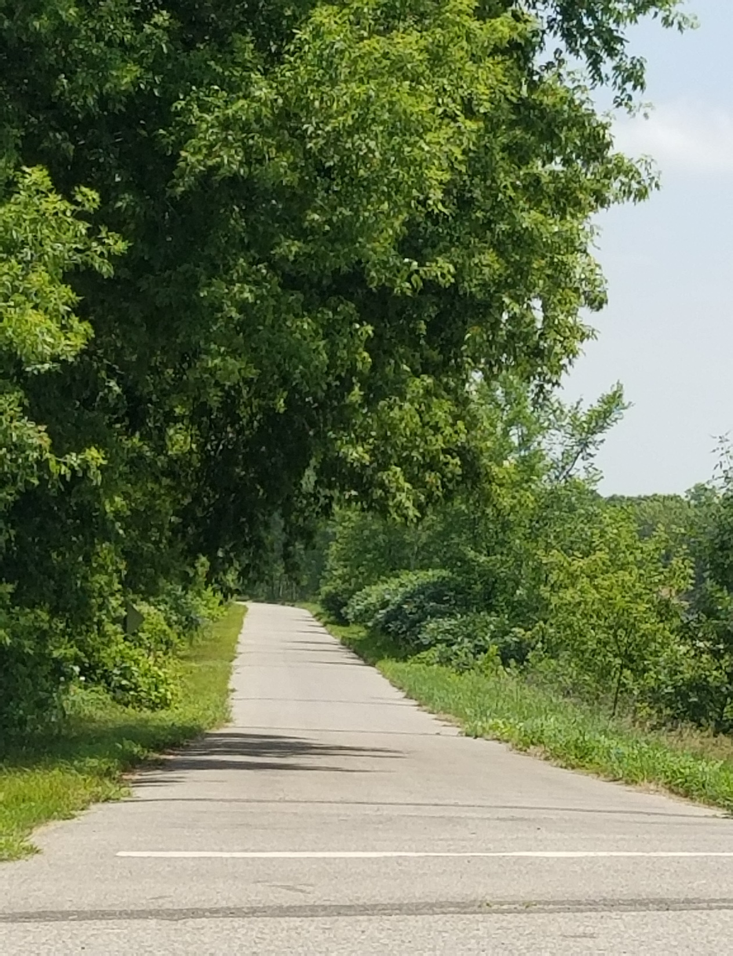
Operating Budget
The nine main elements of our
General Fund

Slide 13
Police Department
1
The Alexandria Police Department provides safety and connectivity to all of the citizens who live or visit this city by:
Positive partnerships
Staying well trained
Using advanced technology
Building community involvement
This department answered *18,000 calls in 2018 and issued * 1,100 tickets. *approximate numbers

Slide 14
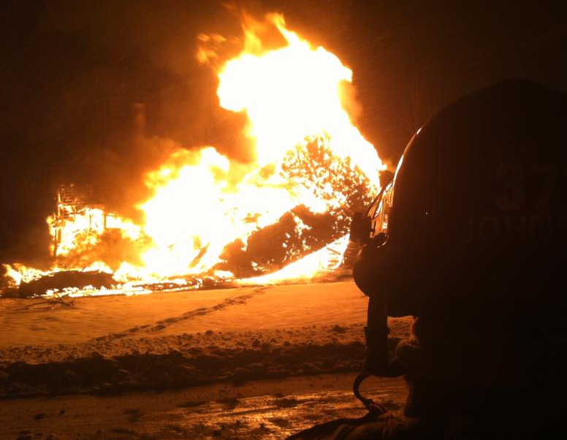
Fire Department/Emergency Mgmt.
2
The Alexandria Fire Department (1 FT Chief and 31 volunteers) provide and protect:
Life safety
Fire Suppression
Fire prevention and education
Technical rescue
Fire system inspections
Disaster response
Emergency management
In 2018, this department answered 218 calls totaling 5,589 man hours.

Slide 15
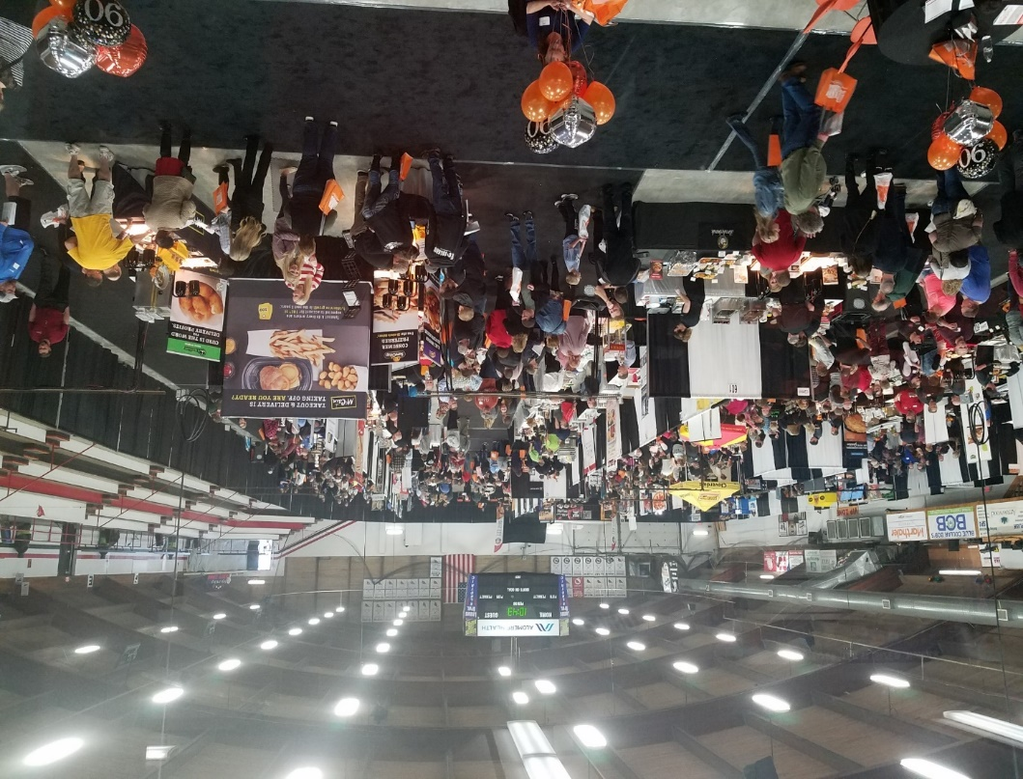
Runestone Community Center
3
In 2018, just over 3,500 hours of ice were sold.
The RCC is a long standing multi-use facility that serve the Alexandria region by:
Offering flexibility to host a diverse group of ice and dry floor events
Making a significant economic impact to the business of Alexandria
Providing space to host large events for non-profit organizations
Used as a significant solution to Emergency Management community needs/plans
Hosted 20 floor shows/events with attendance of over 20,000

Slide 16
Public Works: Streets
4
Streets are often the first impression of any community. This department takes pride in these service areas:
Street sweeping
Storm water management
Snow and ice control
Asphalt maintenance
Mowing, trimming and spraying
Sidewalk repair
Special event set up
In the Winter of 2018-19, this department hauled over 3,000 loads of snow.

Slide 17
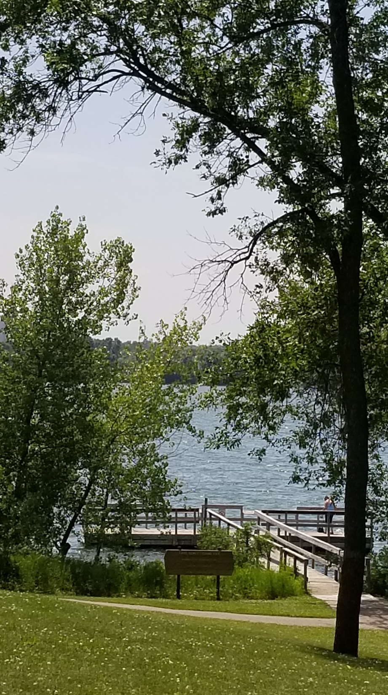
Public Works: Parks
5
This department is a key, valuable asset in maintaining our visual appeal to all by:
Mowing and trimming
Flowers and landscaping
Recreational ice at Noonan’s Park
Snow removal
Tree removal/trimming
Park and building maintenance
This department maintains 250 acres covering 24 parks

Slide 18
Airport
6
AXN averages 70 operations a day and is home to more than 60 aircraft and 6 businesses.
Alexandria’s airport ranks 13th busiest among all 134 public airports in the state, including all commercial airports such as MSP.
The Alexandria Municipal Airport excels in community partnership and economic impact ability by servicing:
The Medical industry as regional medical transportation hub
The Manufacturing industry as overnight freight deliveries are utilized

Slide 19
Community Development
7
Proper planning for any thriving community is key. This department provides services in these areas:
Planning/Zoning
Land Use
Building Code consultation
Building Plan review/Permits
Site Inspection
Construction Storm water Mgmt.
Contractor Education
Rental Registration
Nuisance Enforcement
Housing/Loans
From 2003-2018 the Building Department permitted over $905 million dollars in construction.

Slide 20
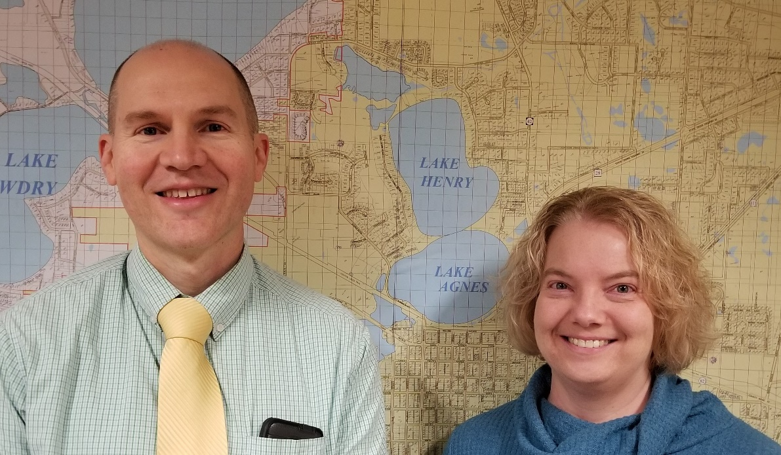
Assessing
Of the 7,084 parcels that could be inspected in city limits, this department visits 1,416 each year.
8
This department directs and manages the valuation and classification of all property in the City by:
Physically inspecting all properties in the city
Setting values for all properties on an annual basis
Responding to inquires from members of the public about their work.

Slide 21
Administration/Finance
9
This department is the central administrative hub of the city executing functions and work in these areas:
In 2018, the Finance Department managed $31,039, 900 of cash inflows spread over 51 governmental funds.
Preparing the annual city budget
Strategic planning
Policy development
Employee assistance and engagement
Financial planning and management

Slide 22
Liquor Stores
$225,000 in profits poured back into the community annually.
*
* Downtown and Plaza Liquor Stores operate as a separate Enterprise (for-profit business) Fund
Yearly deposits into the general fund reduces property tax levy
Community partnerships
Promotes public awareness of municipal work and projects

Slide 23
2020 Budget
Making “cents” of it all

Slide 24
Liquor Stores
2020 Budget
$7,303,009 from the property tax levy
(4.50% increase from 2019)
$5,420,463 from other revenue sources

Slide 25
Liquor Stores
Anticipated Other Revenue Sources
Local Government Aid - $1,557,657
ALP Payment-in-Lieu of Taxes - $1,000,000
RCC Ice Rental - $465,000
Building Permits - $375,000
Natural Gas Franchise Fee - $325,000

Slide 26
Where does your $1 go?
$1
Capital Project $ .22
Parks $ .07
City Attorney
$ .06
ALASD $ .08
Administration $ .10
Police $ .22

Slide 27
Liquor Stores
The Bottom Line
(City Taxes)
In 2020, house valued at $150,000 pays $606.06
2019 = $606.10
In 2016, same house valued at $150,000 paid $630.00
How can this be? Growth in Tax Base.
$150,000 house increases value 3% from 2019-2020
City Taxes = $624.24

Slide 28
Liquor Stores
Nice numbers, but how do you compare with other cities?
Review of Property Tax Rates in 22 Greater Minnesota Regional Centers (2016)
Average City Tax on a $150,000 home
22 Regional Centers* - $872
City of Alexandria - $630
*Regional Center = Greater Minnesota cities between 8,000 and 30,000 in population
(examples: Bemidji, Brainerd, Hutchinson, Marshall, New Ulm)

Slide 29
Liquor Stores
What is the deal with the Proposed Property Tax Notice?
Three Steps in the Process
Values and Classification
Proposed Tax
Property Tax Statement (Mailed in Spring of 2020, along with Assessed Value for Taxes Payable 2021)
Breakdown of Taxes By Jurisdiction

Slide 30
Questions

