Slide 1
2022 Preliminary Budget
And Tax levy
September 27, 2021

Slide 2
What is a budget?
The budget is the single most important policy document a local government adopts
Statement of Priorities
Control, Management, and Planning Tool
Our WHY: To Make Alexandria the Place You Choose

Slide 3
2022 Budget Process
Budget Committee:
What Happens Tonight:
Meets April-August
Review budget requests from outside entities and department heads
Recommendation to City Council
Beginning, not the end
Tonight’s purpose to adopt a preliminary tax levy and budget
Going forward, the proposed tax levy can go down, but cannot go up
All other budget elements still can be modified
Truth in Taxation Hearing on December 13

Slide 4
2022 Budget Highlights
2021 Budget was Defined by COVID:
2022 Budget Priorities:
Early Retirement Program
Eliminated positions
Flat budget for non-personnel items
Smallest levy increase in many years
Evaluate impacts of COVID
Strategic use of tax levy and ARPA funds to enhance services
Replace lost positions with positions of highest need as determined by the City Council
Information Technology
Police
Community Development

Slide 5
Proposed Budget Breakdown
2022

Slide 6
2022 General Fund Budget
$10,401,211

Slide 7
2022 Debt & Discretionary Fund Levies
$3,077,815

Slide 8
2022 Proposed budget Breakdown:
$10,401,211
$13,479,026
7.9%
$3,077,815
2022 General Fund Budget
2022 Proposed Total
2022 Debt & Discretionary Levies
2022 Proposed Levy Increase
2022 Proposed Levy
2022 Proposed Total

Slide 9
Strategic Alignment
Operational Excellence
Long Term Planning
Sustainable Infrastructure
Safe Communities
Economic Vitality
Communications

Slide 10
2022 Operating Budget

Slide 11
Police Department
2022 Highlights:
Community Paramedic Partnership
ATCC Internship Program
Emphasis on employee training and wellness
Additional Officer Position
For 2020, there were 16,204 calls.
So far in 2021, there have been 11,707.

Slide 13
Fire Department -Emergency Mgmt
1 FT staff (Fire Chief) and 29 Volunteers
3 new firefighters added in 2021
Continuing challenges in finding new volunteers
Evaluating future service models
New Aerial set to arrive in late 2021; New rescue truck in 2022
Focus on employee wellness
Hazard Mitigation Plan Update
AFD responded to 199 calls in 2020 62 of them were active fires

Slide 15
Runestone Community Center
In design phase for expansion of the Runestone Community Center
Return of dry floor events in 2021
Busy schedule of ice events included more spring/summer tournaments
COVID required significant changes to operations
In one year, the Zambonis put on the same amount of miles that it takes to drive to California

Slide 17
Public Works: Streets
All 700 yards of sediment collected in the street sweepers is recycled into class 5 for other road projects
2022 Highlights
Annual overlay project
Increase in asphalt repair budget
Additional funding for sidewalk repair/improvement
TMDL implementation
18th Avenue construction

Slide 19
Public Works: Parks
High use during first full year of City Park Pickleball courts
Planning stages for improvements to Knute Nelson Memorial Park
Lease Program for Public Works Vehicles
Management of additional trails/sidewalks
The Park Department maintains 250 acres of land: 22 parks, 3 parking lots and 20,000 flowering plants.

Slide 21
Airport
The current land of the AXN was once an open land known at Raiter’s Pasture. Airplanes were allowed to land in any direction.
Alexandria’s airport ranks 13th busiest among all 134 public airports in the state for number of based aircraft, including all commercial airports such as MSP.
Completion of new 10 unit T-hanger; rental spaces are now filled
Bellanca Building renovation is compete
GPS Instrument approach on Runway 13 is being evaluated and drafted by FAA
New fuel system in 2022
Runway reconstruction in 2023 or 2024 with upgraded lighting system

Slide 23
Community Development
New building inspector position
Significant increase in building permits
Enhanced abatement of nuisances
Addition of Community Development staff in 2022
The Building Dept serves over 71 square miles of area: 18 COA, 30 2-mile radius and 24 Alex Township.

Slide 25
Assessing
This department directs and manages the valuation and classification of all property in the City.
Integration of new Assistant City Assessor
Adjusting typical duties due to COVID-19
Houses of all types/conditions selling after being on the market for only days or even hours, rather than weeks or months as is typical
New homes being built and sold even with the spike in building material costs
Median sale price of single family homes is over $230,000, up from $210,000 last year
Sales of mobile home parks are relatively rare, but 2 happened in 2021

Slide 27
Administration/ Finance
The City of Alexandria is expected to receive $1,462,600 in Fiscal Recovery Funds through the American Rescue Plan Act
Implementation of new HR software
Management of CARES Act & ARPA funds
New policy development
Finance presentations to City Council
Focus on employee wellness
New strategies for acquisition of capital equipment

Slide 29
Liquor Stores
* Downtown and Plaza Liquor Stores operate as a separate Enterprise Fund
2020 and 2021 have seen significant increase in sales
Evaluating how to use liquor stores funds for specific capital projects
New website with online ordering is now live
Shop ONLINE!
Alexandrialiquor.com

Slide 31
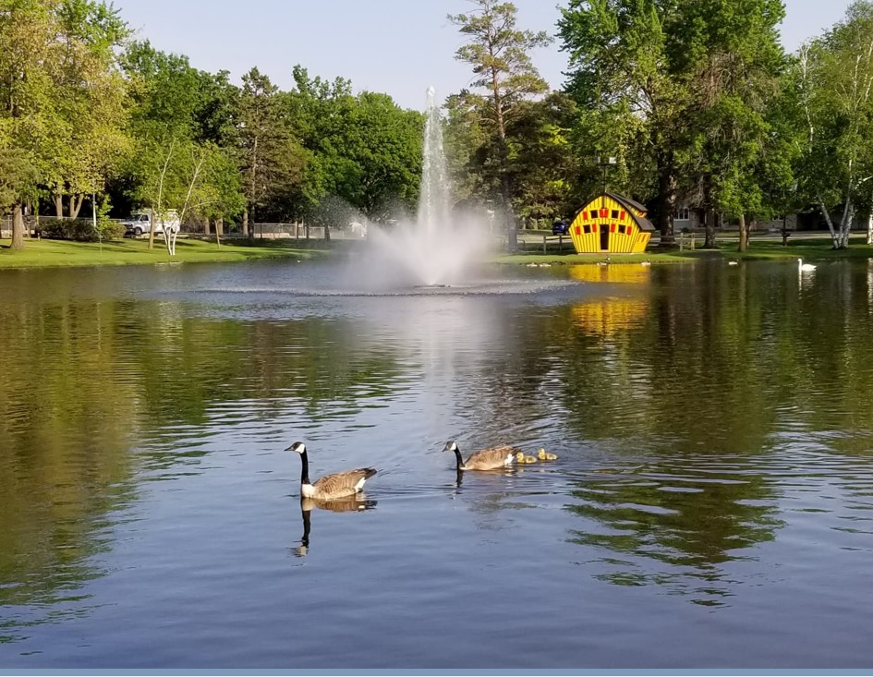
2022 Budget Analysis

Slide 32
Budget Comparison:
$7,964,897 from the property tax levy (7.90% increase from 2021)
Operating Budget (General Fund) increases by $404,610(4.05%)
$5,524,129 from other revenue sources
2021 Actual vs. 2022 Proposed

Slide 33
Revenue Sources
Local Government Aid – $1,591,153
ALP Payment-in-Lieu of Taxes – $1,000,000
RCC Ice Rental – $473,267
Building Permits - $375,000
Natural Gas Franchise Fee - $325,000
Top Five Revenue Sources after Property Taxes:

Slide 34
How are City tax dollars spent?
$0.21
$0.03
$0.61
$0.04
$0.06
$0.07
$0.10

Slide 35
The Bottom Line:
In 2022, house valued at $210,000 pays $839.66
In 2018, a house valued at $210,000 paid $855.68
How can this be? Growth in Tax Base
20.7% growth from 2018-2022
Growth is a combination of new development and increased property values

Slide 36
Regional Center Comparison
Property Tax Levy Increase from 2020-2021
Average - 3.71%
Alexandria - 1.08%
2021 City Taxes for a $210,000 Home
Average - $1,313.44
Alexandria - $820.68
2021 Levy + Local Government Aid Per Capita
Average - $724.91
Alexandria - $625.38
2021 City Tax Rate
Average 62.54%
Alexandria 39.08% (lowest rate among all 22 cities)
How does Alexandria stack up against 22 other regional center in some key budget/tax metrics?

Slide 37
What’s Next?
Tell us what you think!
Participate in the Final Budget Hearing on December 13, 2021 at 7:15pm

